Slide 1
— H&M Personalized Recommendation System
Instructor: Ms. Thuy Nguyen
Course: Practical Data Science

Slide 2
TABLE OF CONTENT
Introduction
Methodologies
Results
Discussion
Recommendations

Slide 3



Meet the team: Group 15
Giang Nguyen
(s3866617)
Bao
Vo
(s3823477)
Anh Phan
(s3810148)

Slide 4
— Introduction

Slide 5
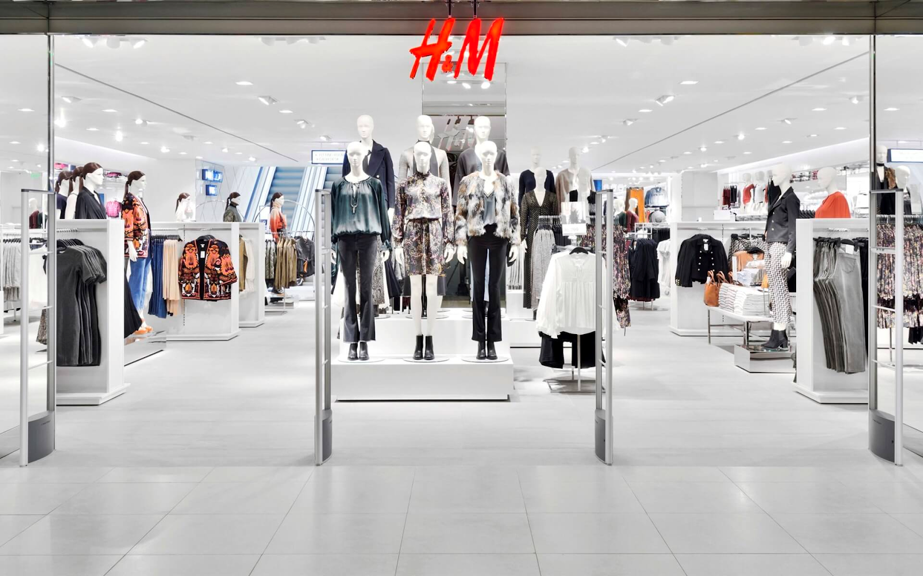
Business Case
Research question: "Build a recommendation system that recommend products to H&M new and return customers.

Slide 6
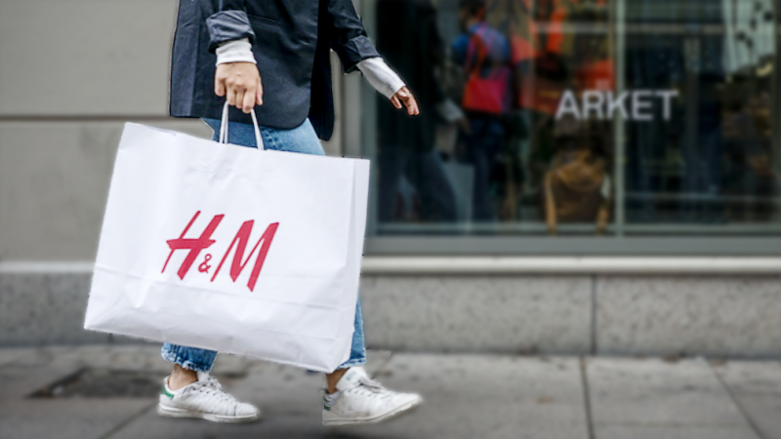
Dataset
Retrieved from a Kaggle Competition named “H&M Personalized Fashion Recommendations”
Dataset types ranging from purchase data to product and product image data.
The datasets selected include:
Transactions
Articles
Article images

Slide 7
Development Approaches
Content-based Image-based filtering
Collaborative filtering

Slide 8
— Data Preparation

Slide 9
Data Overview
Transactions: information about purchases made by customers (id, date, price, etc.)
Articles: information about fashion products (id, name, color, section, …)
Article images: pictures of the items in the article dataset

Slide 10
Data Cleaning
Data | Technique
Duplicate records | Remove duplicate records
Missing values | Transaction dataset: drop rows with missing values Article dataset: remove records that do not have corresponding images
Outliers | IQR method (outliers are detected but not removed)
Unexpected data | Filter articles that have been bought more than 10 times

Slide 11
— Methodologies

Slide 12
— Approach 1:
Item-based collaborative filtering

Slide 13
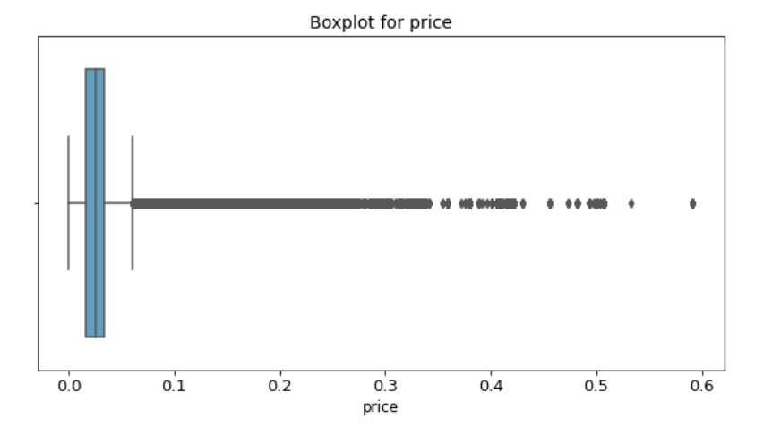
Data Preprocessing
Check & remove duplicate records
Filter the data to get the latest transactions
Find outliers

Slide 14
Future Engineering
We have three basic step in future engineering
Get the potential customers (RFM analysis)
Count the best-sales article_id
Create new column “bought”

Slide 15
Latent features
The features that cannot observe directly from the dataset
SVD or NMF to factorize the item-item similarity matrix into a lower-dimensional representation, which captures the most important characteristics of the data

Slide 16
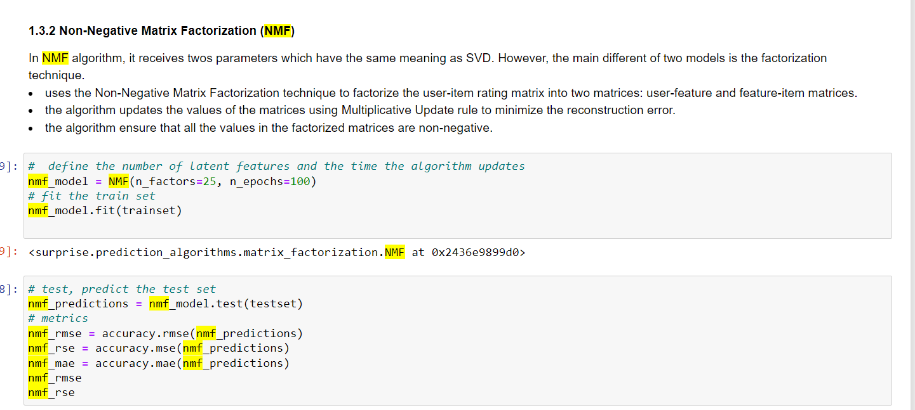
Modeling
Non-Negative Matrix Factorization (NMF)

Slide 17
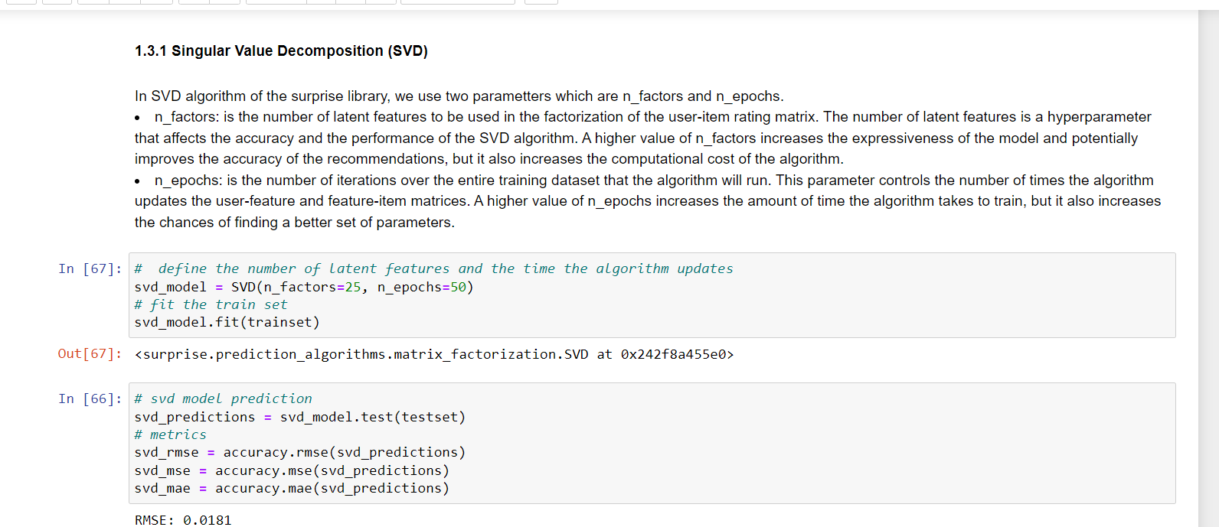
Modeling
Singular Value Decomposition (SVD)

Slide 18
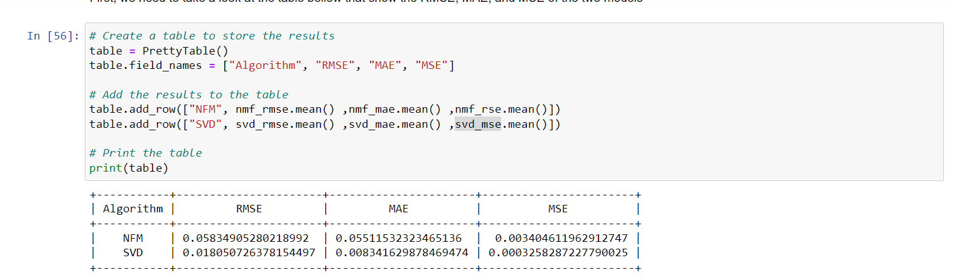
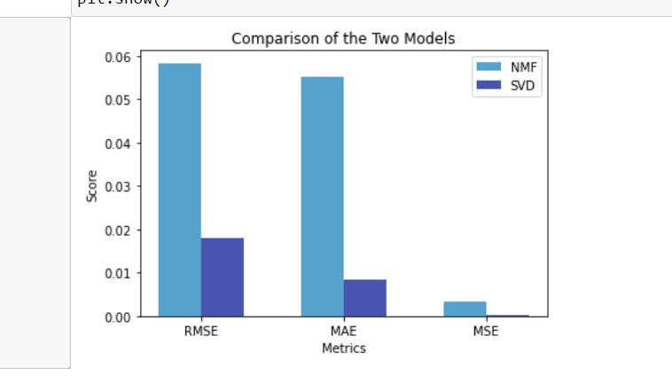
Final Modal
SVD Model

Slide 19
— Approach 2:
Content-based image-based RecSys

Slide 20
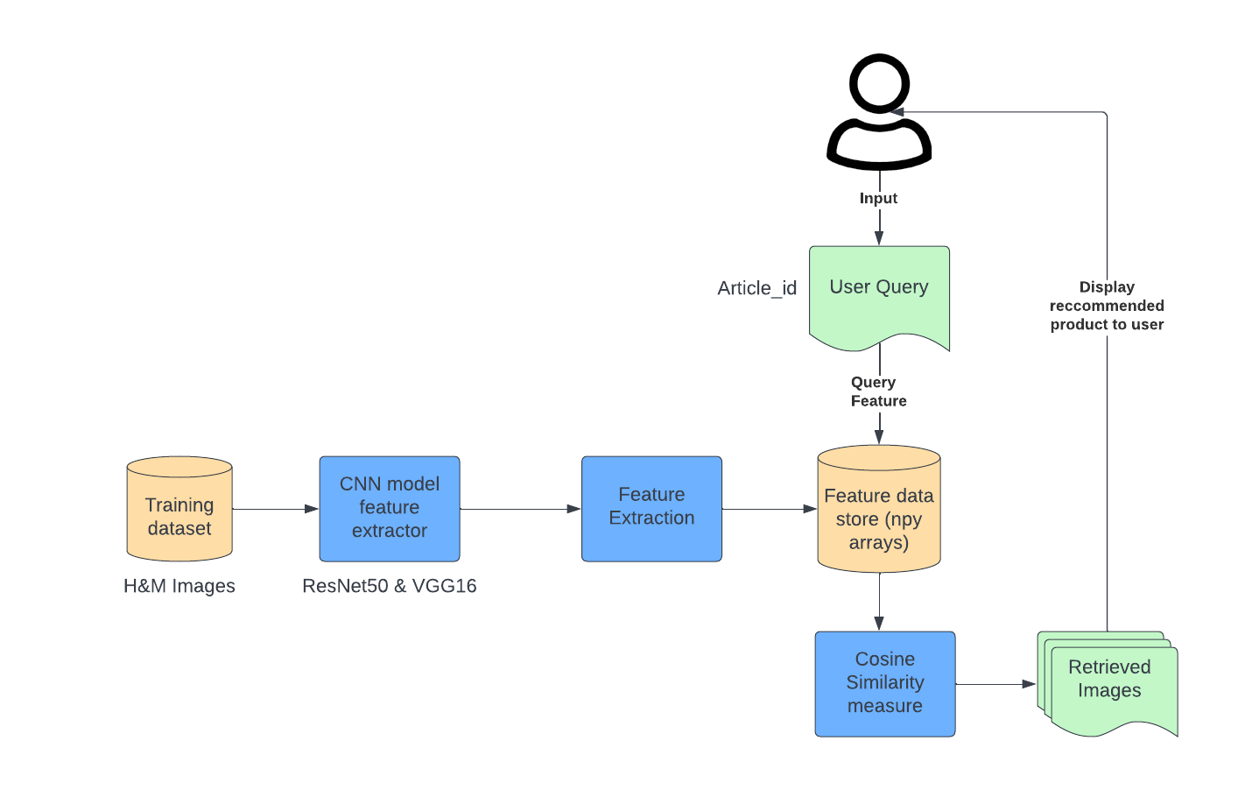
Architecture

Slide 21
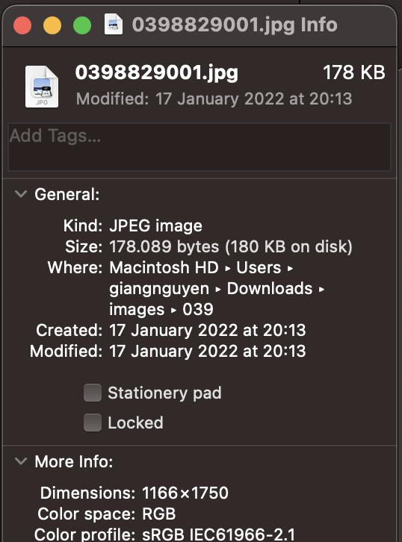
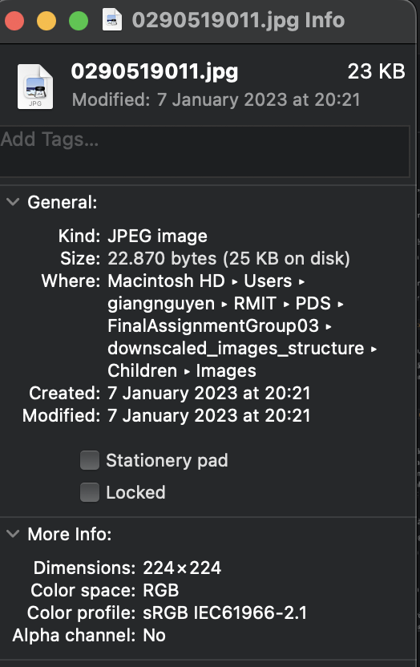
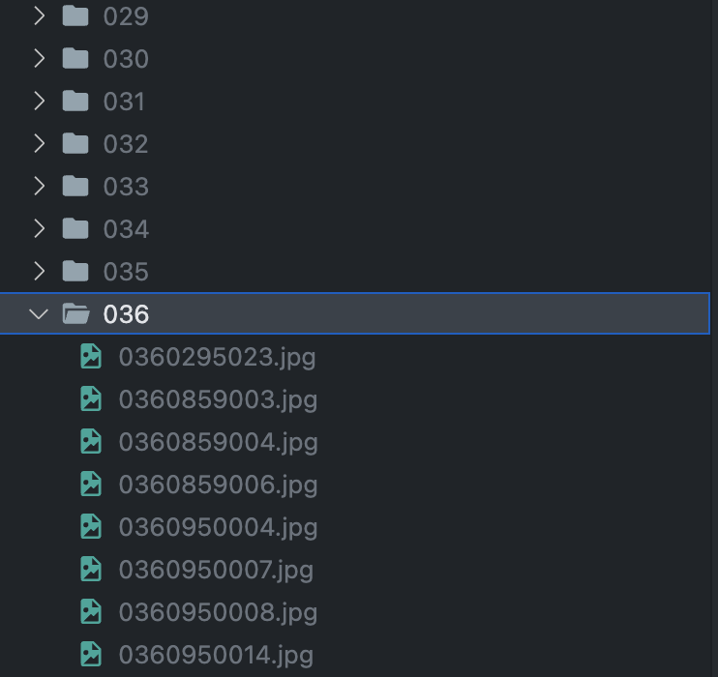
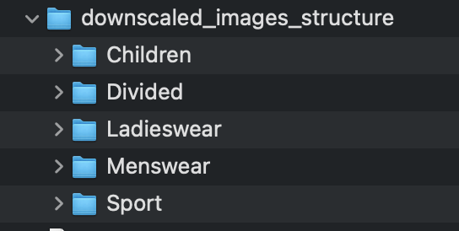
Data Preprocessing
Image Downscale
from ~180kb/img
(> 1000x1000 px) →
20kb/img (224x224 px)
Image Metadata-based grouping
grouped into subfolders by index_group_name for feature extraction
Implementation assumption:
Given a customer is browsing a product, they will want to be recommended products in the same category

Slide 22
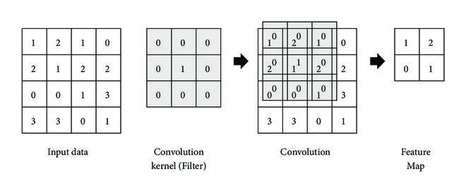
Feature Engineering
Utilized ResNet50 and VGG16 to generate feature maps from our dataset images, leveraging their pre-trained ability to extract complex features.

Slide 23
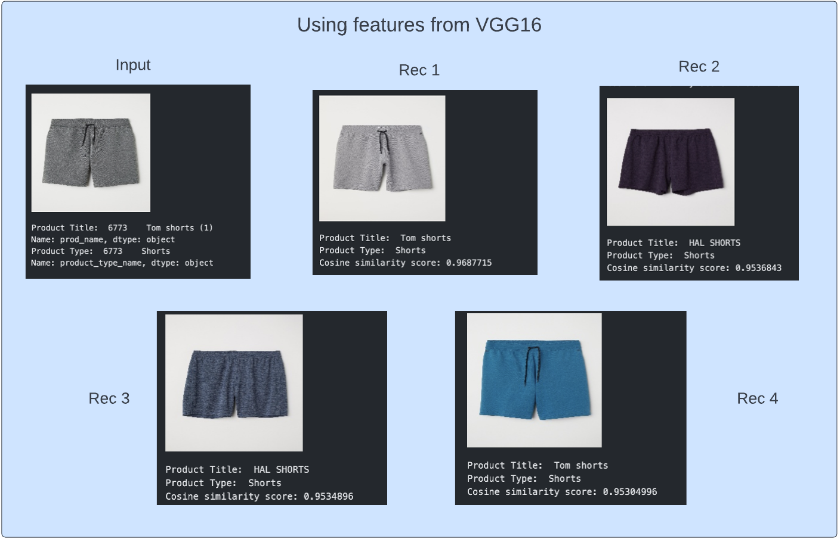
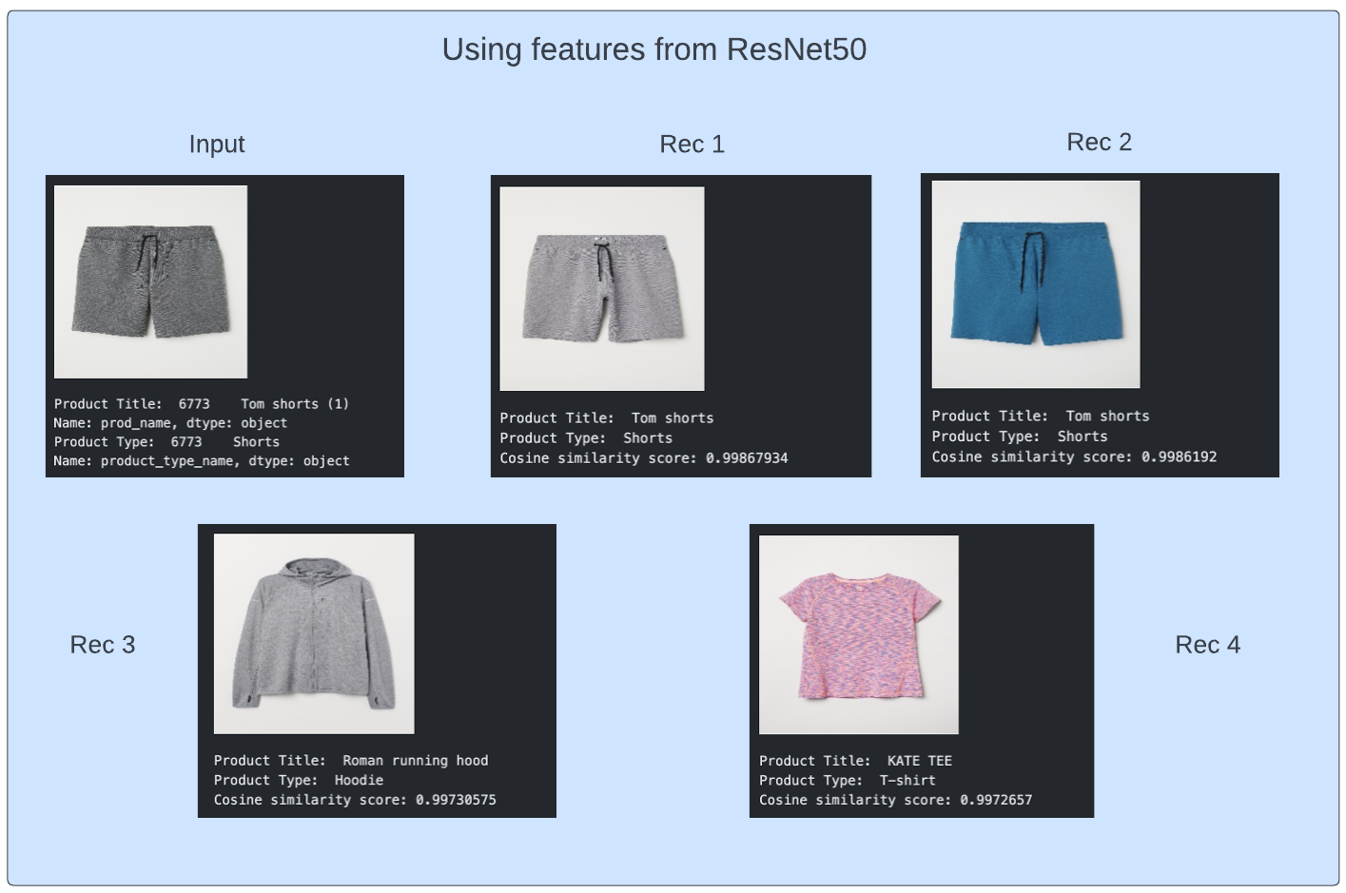
Results and Evaluation
Overall, features extracted from
VGG16 gives more relevant
results compared to ResNet50

Slide 24
— Discussion

Slide 25
Outcome
2 functional recommendation models corresponding two development approaches
Data visualizations of valuable insights regarding H&M’s business and the fashion industry
A report documenting our development process together with evaluation and analysis of the results

Slide 26
Limitations & Recommendations
Limitations:
Offline evaluation metrics are used for validation of the recommendation systems
controlled environment and can provide more accurate results but it doesn't reflect the real-world scenario
Both systems are susceptible to scalability challenges
Recommendation:
Perform online evaluation framework which takes real customer interaction into account when validating the system - deploy the model into production.
Implement the hybrid model leveraging the strengths of both approaches.

Slide 27
—
Project demo

Slide 28
—
Do you have any question?

Slide 29

—

